Slide 1


Slide 2


Slide 3


Slide 4
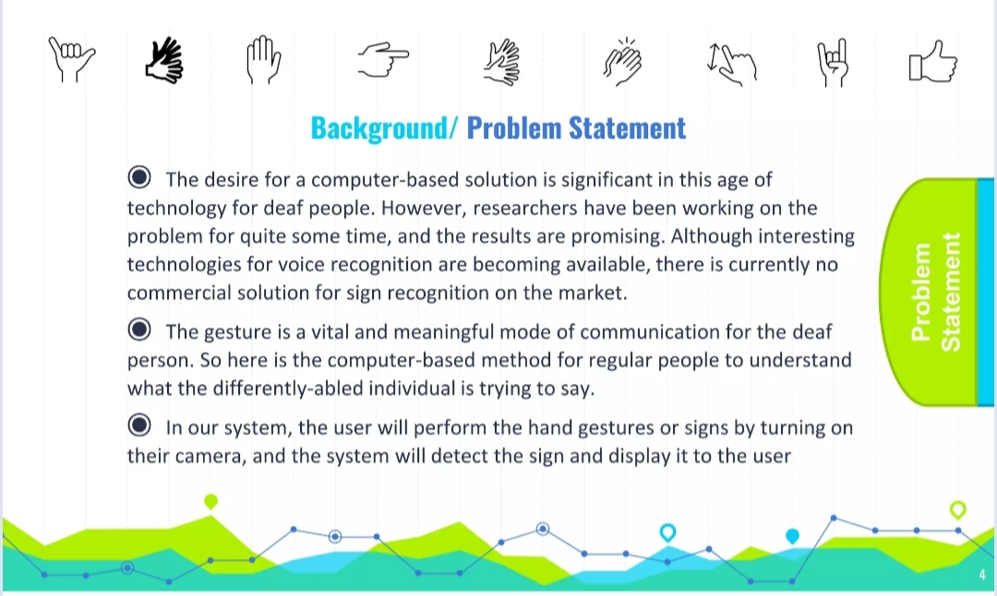

Slide 5


Slide 6
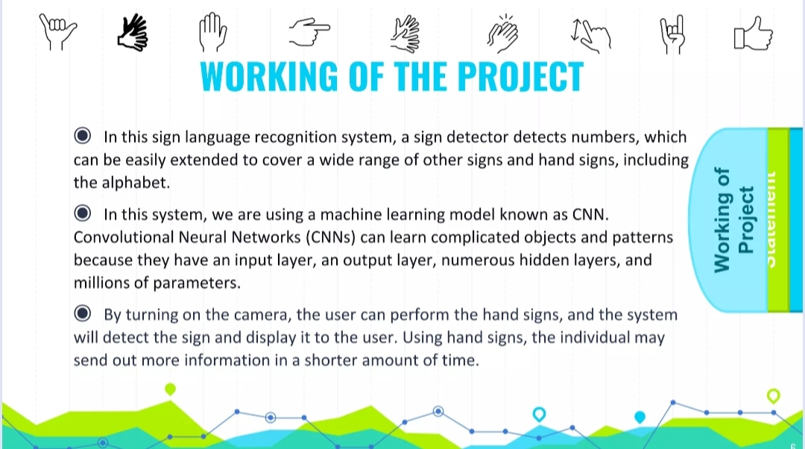

Slide 7
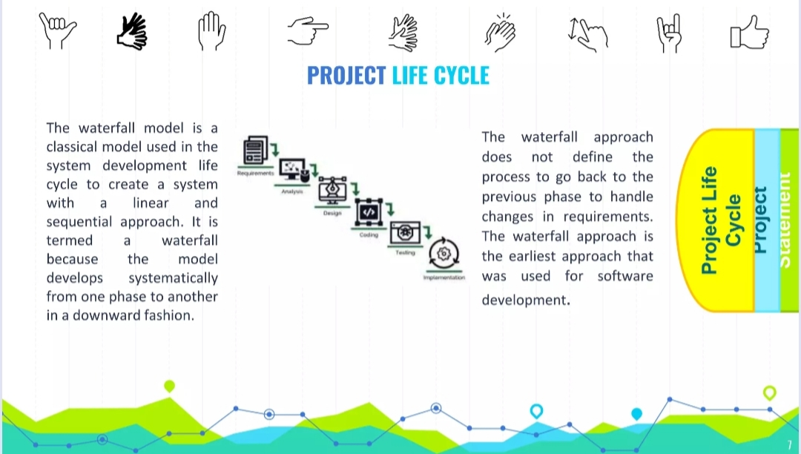

Slide 8
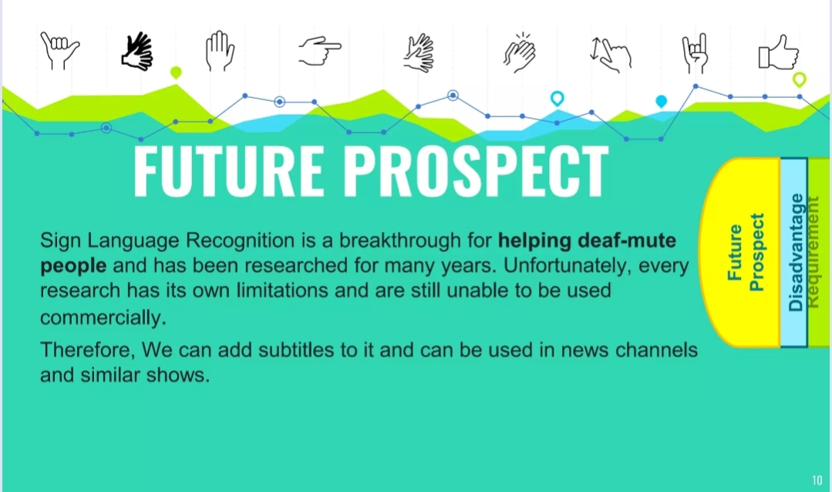

Slide 9


Slide 10
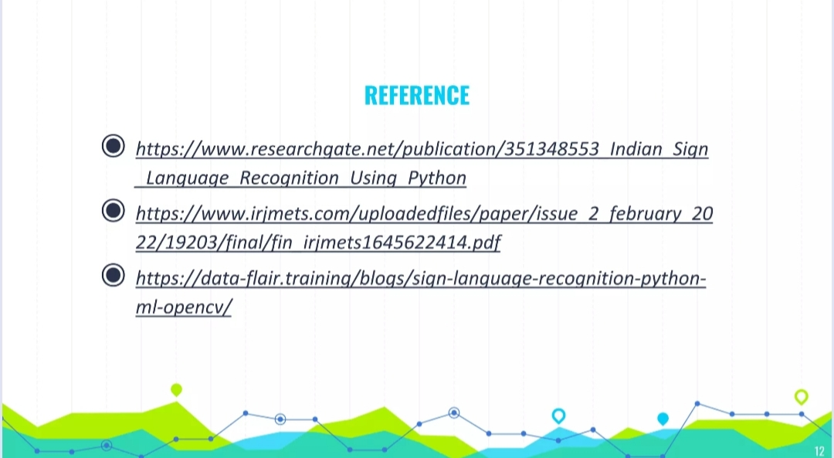
Video Link : https://drive.google.com/file/d/1dHgN-pwcM1TdTjVSkEp9_HEivVmU2f4E/view?usp=drivesdk

